Slide 1
Your data roadmap
and 90-day plan
What will I fix first, who will own it, and how will I know it worked?
Applied AI and Automation | Session 12 of 12
KLAi Professional Learning | Jotham Martin Wambi
Notes:
Welcome to the last session. Last time you decided whether your own task is worth doing. Today you turn your data assessment from Session 4 into a roadmap with owners, dates and measures, plan what to test first, and set your check-ins. You share the roadmap with a partner.
There are no presentations, no scores and no judges. The aim is a plan you can start tomorrow.

Slide 2



Today in one view: what you will leave with
By the end of today you will have
A data roadmap built from your Session 4 gaps: actions, owners, dates, effort, dependencies and success measures
A first test planned, with retrieval before any training
A 90-day plan with day 30, 60 and 90 check-ins, shared with a partner, and the follow-up kit
Notes:
Here is what you leave with. A data roadmap built from your top three gaps, with owners, dates, effort, dependencies and success measures. A plan for the first test, with retrieval before any training. And a ninety day plan with check-ins at day thirty, sixty and ninety, which you share with a partner. Most of the session is your own work.

Slide 3
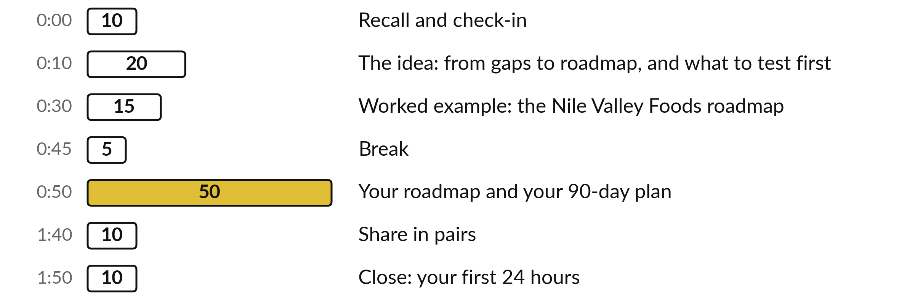
Today: 60 of the 120 minutes
are your own roadmap
60 of the 120 minutes are yours: your roadmap, your plan and your pair.
Notes:
Three parts matter most today. I talk for twenty minutes about turning gaps into roadmap lines and what to test first, then fifteen minutes on a worked example from Nile Valley Foods. After the break you spend fifty minutes on your own roadmap and plan, and ten minutes sharing it in pairs.
The last ten minutes are your first twenty-four hours. If we run late, I shorten my talking.

Slide 4

Three questions from last time
1. Which cost never goes away, even when the work is automated?
2. What do you compare a result with when you judge a saving?
3. What is a stop rule, and when do you write it?
Answer aloud first. Then we check together.
Notes:
Three quick questions from Session 11. Answer aloud first, and then we check together. It is a warm-up to bring last time back.
Question one. Which cost never goes away, even when the work is automated? Take a moment.
A good answer is this. Review time: a person must still check the result. It stays in the costs.
Question two. What do you compare a result with when you judge a saving? Say it to yourself first.
A good answer is this. The baseline from your Session 1 task card: how long the task takes today, how often, and where it goes wrong.
Question three. What is a stop rule, and when do you write it? Think about your own task as you answer.
A good answer is this. A number that tells you to stop or change course, written before you start so that nobody argues about it later.
If an answer was missing, your own task card or last workbook page has it. Now to today.

Slide 5



Words we use today
Word | What it means
Roadmap | Dated actions, each with one owner and one measure, in the order they must happen.
Owner | The one person who answers for an action.
Dependency | An action that must finish before another can start.
Success measure | A number someone else can check, such as 0 faults on a recheck.
Check-in | A short report at day 30, 60 and 90, on the Check-in Form.
Notes:
Five words for today. I give the plain meaning of each, and we use every one of them before the end of the session.
Roadmap. Dated actions, each with one owner and one measure, in the order they must happen.
Owner. The one person who answers for an action.
Dependency. An action that must finish before another can start.
Success measure. A number someone else can check, such as 0 faults on a recheck.
Check-in. A short report at day 30, 60 and 90, on the Check-in Form.

Slide 6
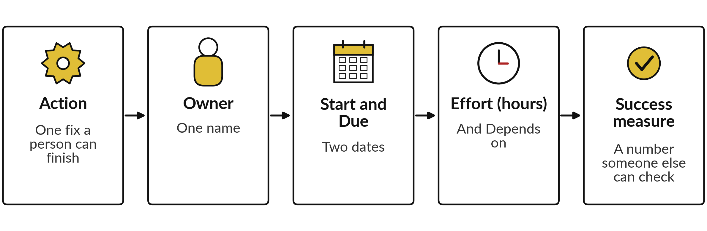
Every gap from Session 4 becomes
one roadmap line with five parts
Phase groups the lines: Protect and clean, Describe and prepare, Test and decide. Status is filled as you go.
Notes:
Start with the pages you wrote in Session 4. Each gap on your list becomes a roadmap line with five parts. The action is one fix that a person could finish in days, such as fix the invoice file. The owner is one name, because an action with two owners has none.
Then a start and a due date, and the effort in hours, marked as an estimate, with a Depends on entry for what it waits for. And a success measure, a number someone else can check. The template adds a Phase column and a Status column. The phases are Protect and clean in the first thirty days, Describe and prepare in the next thirty, and Test and decide in the last thirty.

Slide 7
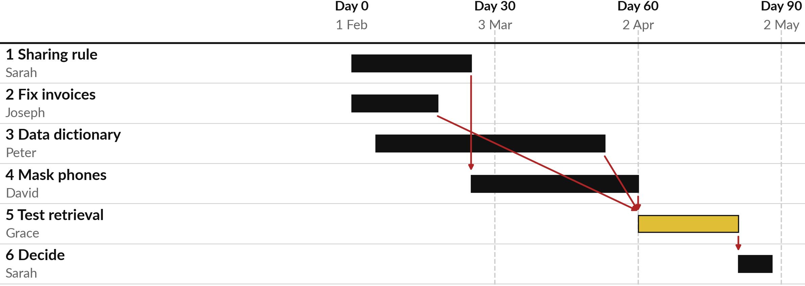
Worked example: order matters, so
rights and cleaning come before the test
NVF example (fictional). Gold: the test. Red arrow: waits for. Dashed: day 30, 60, 90.
Notes:
Here is a roadmap for Nile Valley Foods, starting on the first of February 2027. Each bar is one action with its owner. Red arrows show dependencies. Masking phone numbers waits for the data sharing rule, because the rule says what must be masked. The test of retrieval, the gold bar, waits for the cleaned invoice file, the data dictionary and the masked export.
Nobody should test before the data is ready and allowed. The last action is a decision, with a date. The dashed lines are day thirty, sixty and ninety.

Slide 8






Worked example: six lines, each with an
owner, a date, an effort and a measure
Action | Owner | Due | Effort (hours) | Depends on | Success measure
1 Write the data-sharing rule | Sarah Namukasa | 26 Feb | 4 (E) | None | Rule signed and filed
2 Fix the invoice file | Joseph Mugisha | 19 Feb | 6 (E) | None | 0 faults on recheck
3 Write the data dictionary | Peter Okello | 26 Mar | 8 (E) | None | Every column defined
4 Mask phones in the export | David Kato | 2 Apr | 5 (E) | 1 | 0 phones in the copy
5 Test retrieval | Grace Akello | 23 Apr | 10 (E) | 2, 3, 4 | 16 of 20 right, none invented
6 Decide | Sarah Namukasa | 30 Apr | 2 (E) | 5 | Decision recorded
All dates are in 2027; hours are estimates (E). The template adds Phase, Start and Status.
Notes:
Here are the same six lines under the template’s column names: Action, Owner, Due, Effort in hours, Depends on and Success measure. The template also has Phase, Start and Status. Each line has one owner, a due date, hours marked as an estimate, and a success measure. Look at the measures: zero faults on a recheck, every column defined, sixteen of twenty questions right and none invented.
All are numbers that someone else can check. Notice that the pass line for the test is set before the test runs. Depends on holds the action numbers, so masking phones depends on action one. These figures are invented for the example.

Slide 9


Test retrieval first; train a
model only if that falls short
Test first: retrieval
Later, if needed: training
Readable text with labels
Cut into passages and indexed
Kept up to date
Answers can cite the source
Right to use the data confirmed
Personal data removed
Formatted as example questions and answers
Split into training, check and test sets
Most companies should prepare for retrieval first.
Notes:
Back to Session 0 for the advice on what to test first. Retrieval means the assistant searches your documents and answers from them, citing the source. It needs readable, labelled text, kept up to date. Training or fine-tuning needs much more: a confirmed right to use the data, personal data removed, examples formatted as questions and answers, and separate training, check and test sets.
My understanding is that most organisations should prepare for retrieval first, and consider training only when prompting and retrieval have clearly reached their limit. Retrieval also makes your gaps visible quickly.

Slide 10
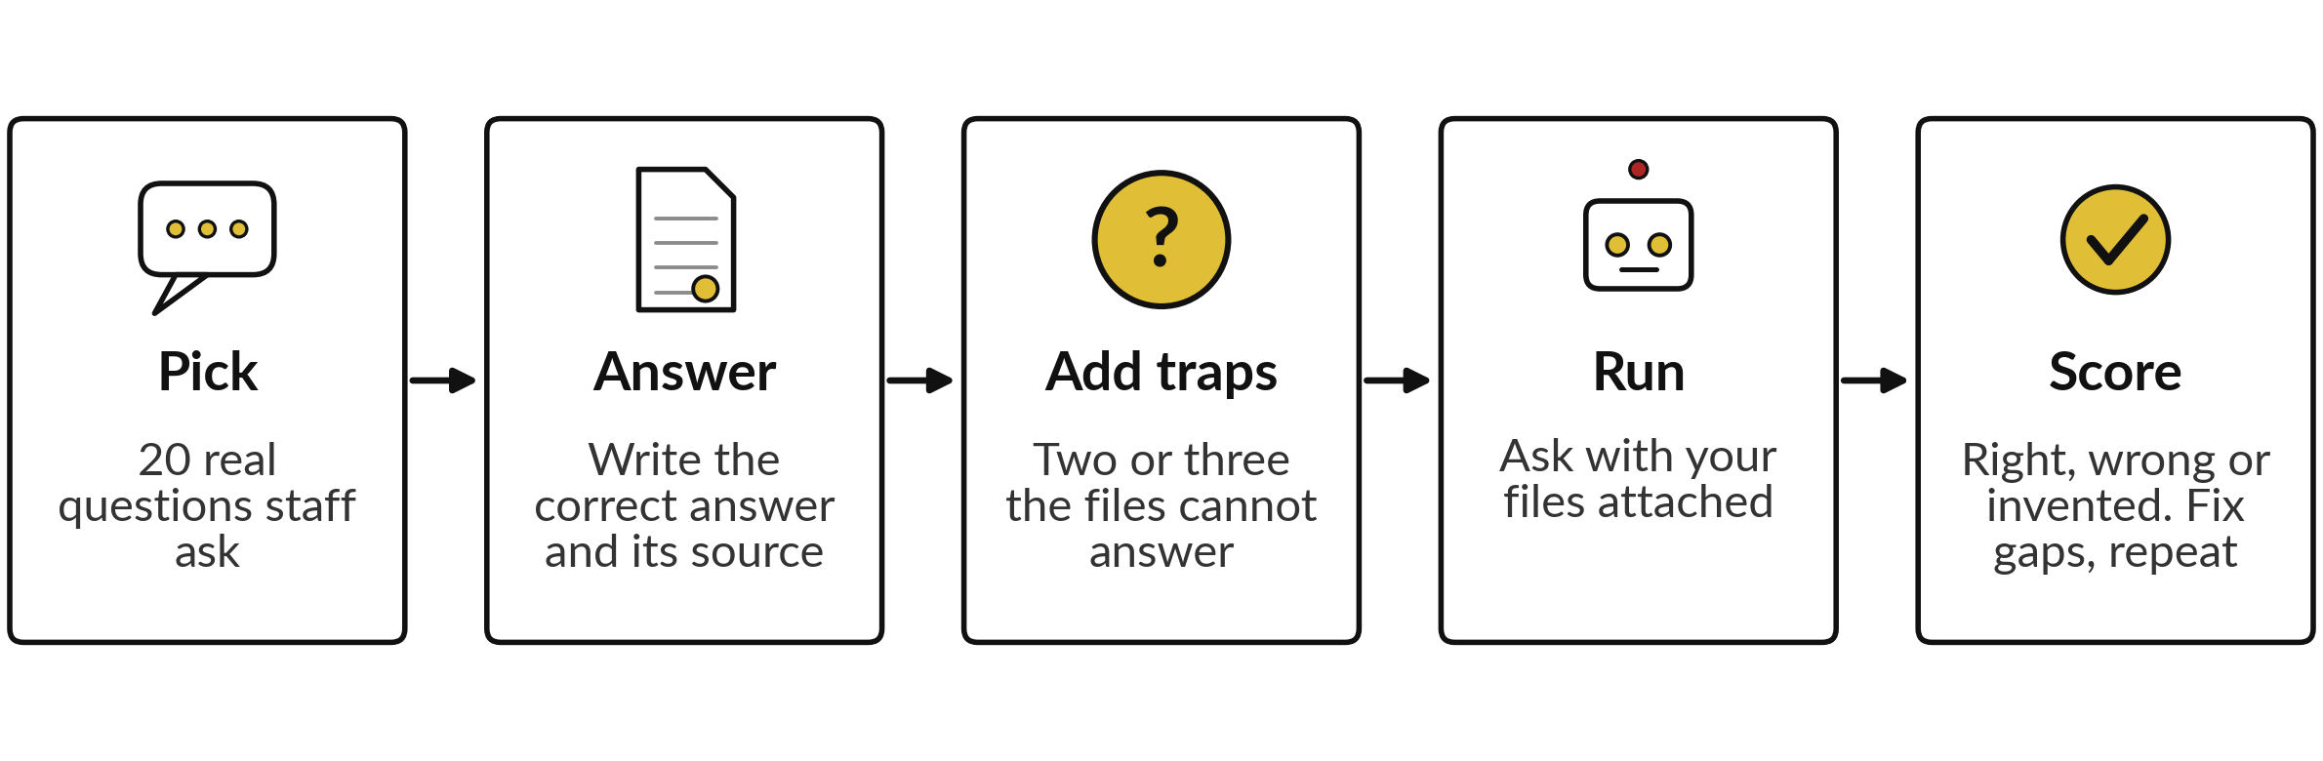
The first test: 20 questions with known answers
Set the pass line first. About 50 questions give a firmer result; 20 is enough to begin.
Notes:
This is the test that closes your roadmap. Pick twenty real questions that your staff ask. For each, write the correct answer and the file it comes from, before you run anything. Add two or three questions the files cannot answer, as we did in Session 2, because a good system says it does not know.
Run the questions with your files attached, then score each answer as right, wrong or invented. Set the pass line first, for example sixteen right and none invented. If it fails, the wrong answers show which data gap to fix, and you run it again.

Slide 11


A success measure is a number
someone else can check
Weak measure | Strong measure | Checked by
Better data quality | Invoice file: 0 faults on recheck by 19 Feb | Sarah Namukasa
Staff know the rules | Every member of staff briefed on the signed rule by 26 Mar | Mary Nabirye
The assistant answers well | 16 of 20 test questions right, none invented | Grace Akello
The data is safe | 0 phone numbers in the copy given to the tool | David Kato
Fictional example. A measure names a number, a date and a checker.
Notes:
Here is the difference between a weak and a strong success measure. Better data quality cannot be checked. Zero faults on a recheck by the nineteenth of February can. Staff know the rules cannot be checked, but every member of staff briefed on the signed rule by a date can.
The assistant answers well becomes sixteen of twenty right and none invented. The data is safe becomes zero phone numbers in the copy given to the tool. Each strong measure has a number, a date and someone who checks it. Rewrite your measures this way.

Slide 12

Three check-ins keep the plan
honest: day 30, day 60 and day 90
Day | Date (NVF) | You bring | The test
Day 30 | 3 Mar 2027 | Check-in Form, roadmap | Are the Session 9 controls in place? Is gap 1 closed?
Day 60 | 2 Apr 2027 | Form and a Results Tracker row | Is any Session 11 stop rule met? Are actions on time?
Day 90 | 2 May 2027 | Form and Sponsor Briefing | Re-score the six areas. Continue, expand, pause or stop.
If nothing runs yet, say which gaps are closed, which test you ran and your score. I contact you; you return the Form.
Notes:
Here is the follow-up kit. At day thirty, day sixty and day ninety you fill in one page of the Check-in Form: what is done, what went wrong, what changed in the policy, and what next. If nothing runs yet, which is likely, answer in terms of your data: which gaps are closed, which test you have run, and what your score is now.
In the Nile Valley Foods example the plan starts on the first of February 2027, so the dates are the third of March, the second of April and the second of May. Choose your own start date and count from it. Each check-in has a test. At day ninety you re-score the six areas and the Sponsor Briefing carries the decision. Nobody is scored. The check-in reports what happened.

Slide 13



Decision: how much will you
take on in the next 90 days?
How many gaps will your roadmap close?
One gap, finished
Three gaps, started
Prove retrieval first
Fix your first gap fully and test it. Recommended for most.
Move all three a little. A result shows later.
Test one folder now. Only if rights are not red.
Say your choice aloud and write it at the top of your roadmap.
Notes:
One decision before the break. How much will you take on?
You can finish one gap and test it. You can start all three, which spreads your effort and shows a result later. Or you can test retrieval on one folder straight away, which is sensible only if your rating on rights is not red. My advice for most executives is one gap, finished, because a closed gap with a measured result is more convincing than three half done. Say your choice aloud, and name the gap and its owner.

Slide 14
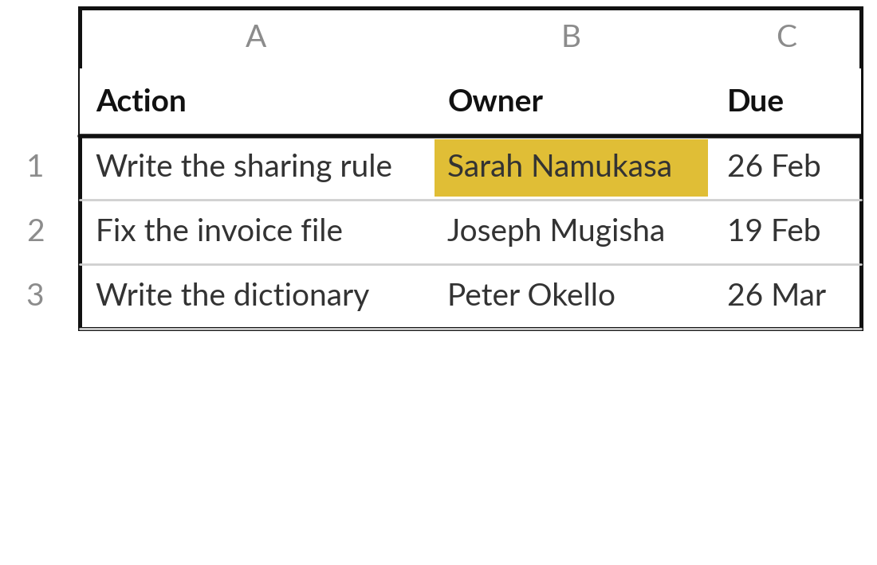
Practice: turn your top three
gaps into roadmap lines
20 minutes
Your own company task
Open the 90-Day Roadmap and write your lines.
Write your start date on the Roadmap sheet.
Write one action for each of your three gaps.
Give each action one owner and one due date.
Add actions until you have six, and set each Phase.
You keep: A roadmap with at least six actions, each with one owner and one date.
Notes:
Take twenty minutes. Open the ninety day roadmap and write your start date. Start with your three gaps from Session 4 and write one action for each, small enough to finish in days. Give every action exactly one owner and one due date that you can put in a diary.
If the owner is not you, write the name of the person you will ask. Then add actions until you have at least six, each in a Phase of Protect and clean, Describe and prepare, or Test and decide, including a test and a decision near the end.
The grey rows in the template are examples, so type over them. I will check that each action has one owner.

Slide 15
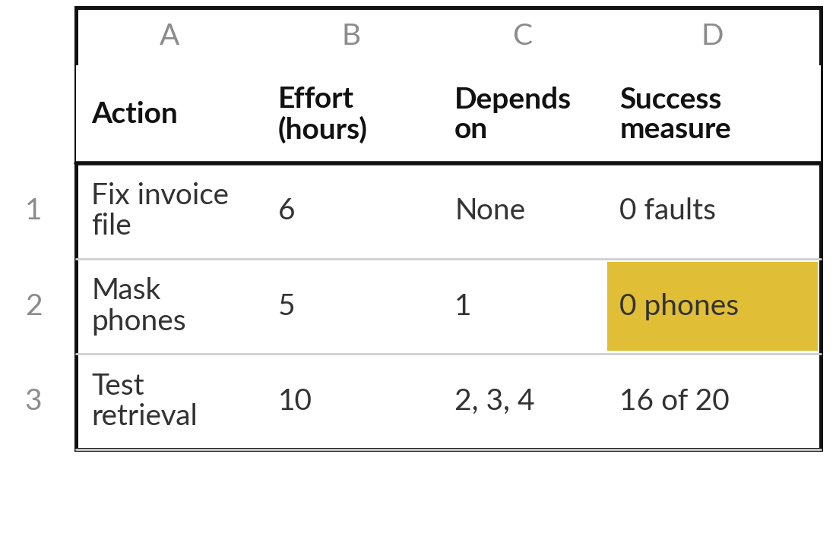
Practice: add effort, dependencies
and a success measure
15 minutes
Your own company task
Complete each line of your roadmap.
Fill Effort (hours) for each action and mark it E.
Fill Depends on with the action numbers.
Rewrite each Success measure as a number someone else can check.
Write 5 of your 20 test questions, with answer and source file.
You keep: Effort, Depends on and Success measure filled, and five test questions written.
Notes:
Fifteen minutes. For each action fill Effort in hours and mark it with an E. In the Depends on column write what it waits for, using the action numbers. Then look at your Success measure column and rewrite any weak one as a number, a date and a checker.
Last, start your first test. Writing twenty real questions with correct answers and source files takes longer than the time you have, so write five now, each with its answer and the file it comes from, including one the files cannot answer. Write the other fifteen as part of your test action.
Set the pass line before you run it. Check that nothing in your plan tests before the data is ready and allowed.

Slide 16
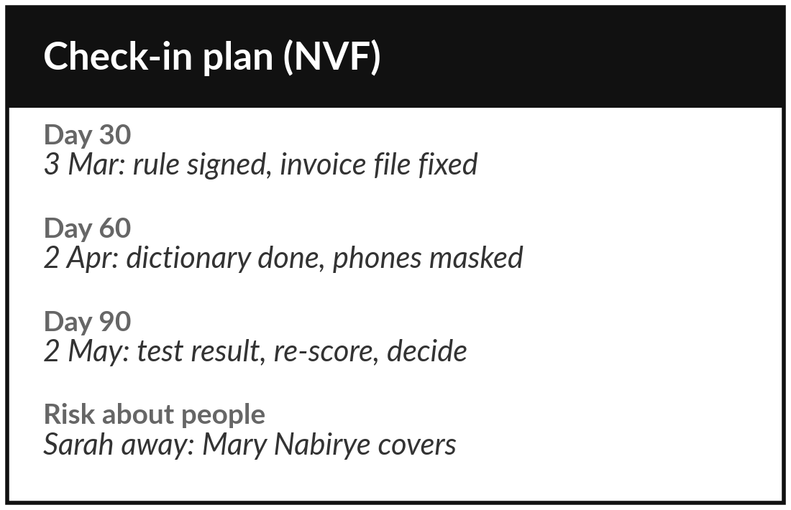
Practice: set your three check-ins
and the risks to your plan
15 minutes
Your own company task
Put your dates and your risks on paper.
Count 30, 60 and 90 days from your start date.
Write the test you will apply at each check-in.
Put the dates on the Check-in Form and in your diary.
List three risks to the plan on the Risks sheet, one about people.
You keep: Three dated check-ins, each with a test, and a risks list.
Notes:
Fifteen minutes. Count thirty, sixty and ninety days from your start date and write the three dates. For each check-in write the test you will apply, using the examples. Put the dates on your Check-in Form and in your diary now, because a date in the diary is a date that is kept.
Then open the Risks sheet and list three risks to the plan itself. At least one is about people, such as the owner being away or leaving. Name who covers, and what happens if the files change before the test.

Slide 17
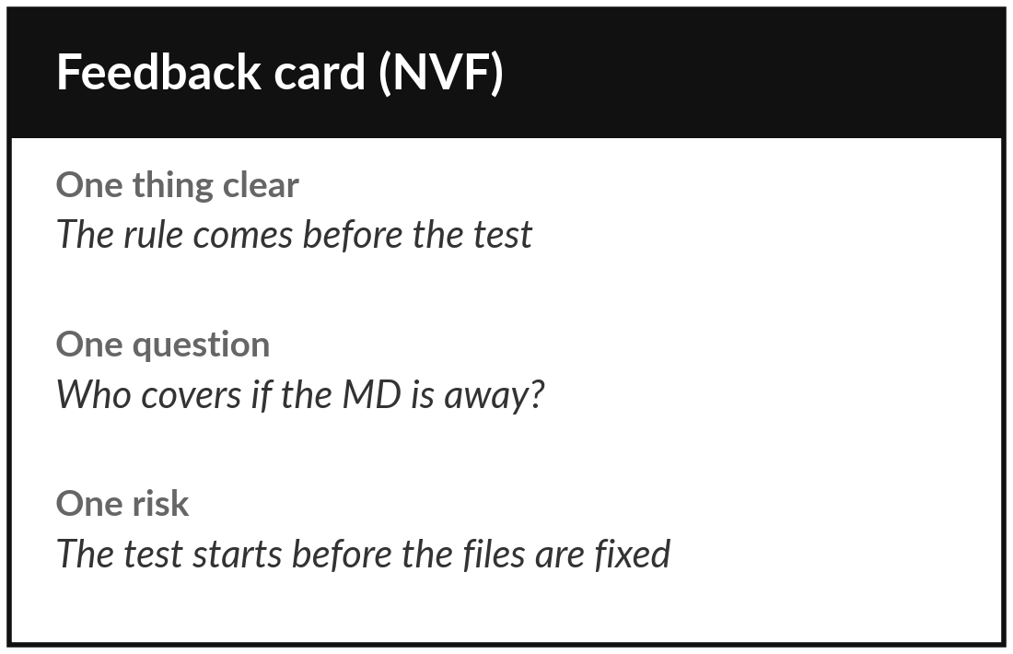
Practice: share your roadmap with a partner
10 minutes
Your own company task
Take three minutes each, then give feedback.
Say your three gaps, your first action and its owner.
Your partner gives three lines: one thing clear, one question, one risk.
Write the lines down.
Change one line of your roadmap because of them.
You keep: Three feedback lines and one change to your roadmap.
Notes:
Ten minutes, in pairs. Each of you has three minutes to say your three gaps, your first action and who owns it. You do not present slides. Your partner then gives three lines: one thing that is clear, one question about something that is not, and one risk to watch.
Write the three lines down and change one line of your roadmap because of them. If you are on your own, I am your partner and I give the same three lines. Nobody scores anybody.

Slide 18
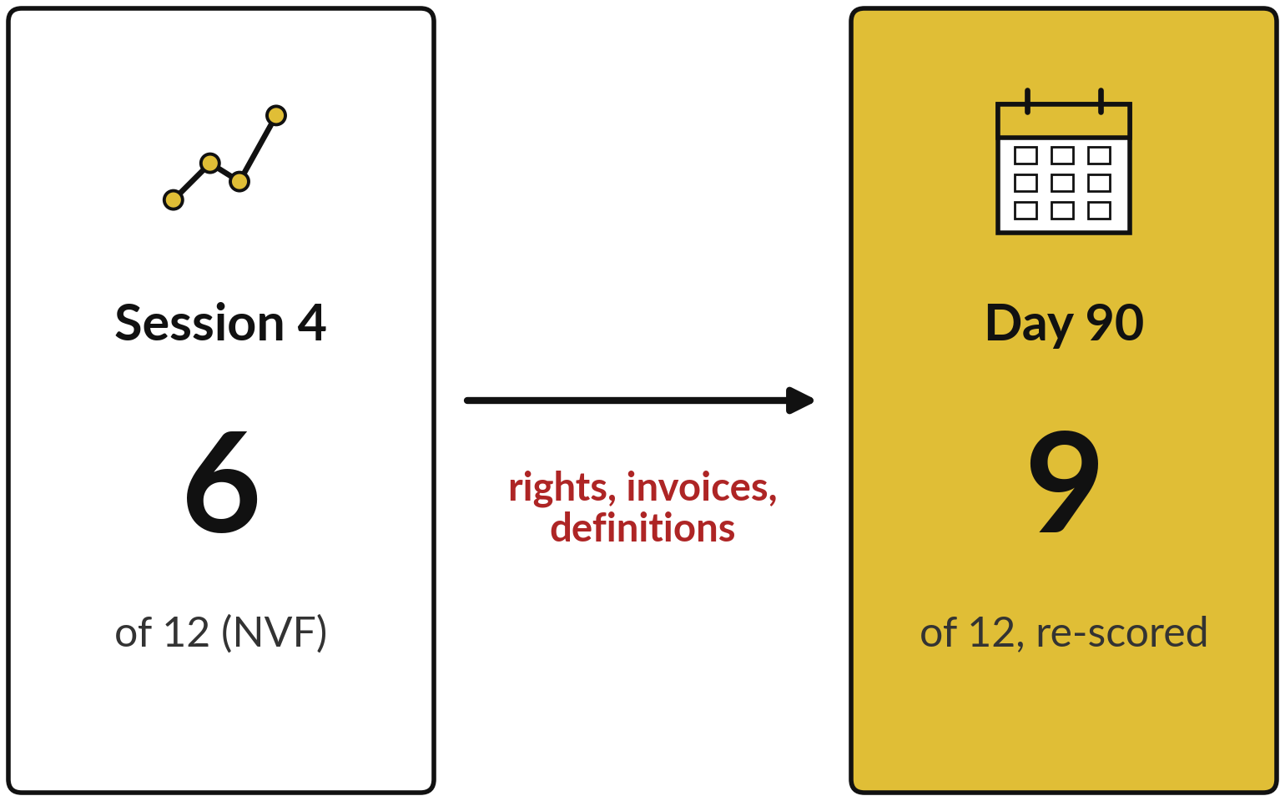
Look back: re-score the same six areas on day 90
The same six areas, scored again by the same rules.
Say your Session 4 total.
Say your day 90 target.
Say one thing you will stop, and one you will start.
Notes:
We finish with a look back. Open your Session 4 scorecard and say your total aloud. Then say what you expect it to be on day ninety, if your roadmap works. At Nile Valley Foods the total was six of twelve. If the data sharing rule, the invoice fix and the data dictionary all happen, rights moves from red to amber, and completeness and metadata move from amber to green, which makes nine.
The target is an example. Then say one thing you will stop doing and one you will start. Small is fine.

Slide 19



Decision: what will you do in your first 24 hours?
Which action will you take within 24 hours?
Book the dates
Name the owners
Start the first fix
Put the 30, 60 and 90 day check-ins in your diary.
Tell each owner their action, their date and their measure.
Do the first small step of action one.
Write the action, its owner and tomorrow’s date at the top of the roadmap.
Notes:
One last decision. What will you do in your first twenty-four hours?
You could book the three check-ins in your diary. You could tell each owner their action, date and measure. Or you could do the first small step of action one, such as sending the email to your lawyer. Choose the one most likely to happen. Write the action, the owner and tomorrow’s date at the top of the roadmap.
You now have a company data assessment, a roadmap and a plan to check it. Thank you for twelve sessions of real work on your own company.

Slide 20
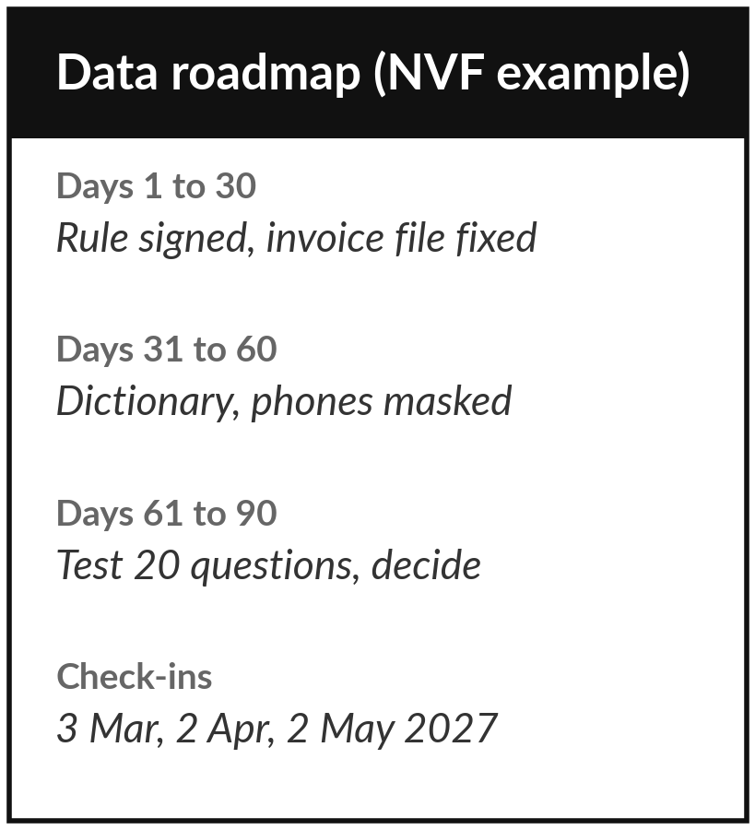
Your first 24 hours and who contacts whom
What you keep from today
Your data roadmap and the follow-up kit (Check-in Form, Results Tracker, Sponsor Briefing), with the dates filled in.
What happens next
The 30, 60 and 90 day check-ins. I follow up by message or call, and you return the Check-in Form and the Results Tracker.
Notes:
These are your first twenty-four hours and who contacts whom. Within a day, do the first small step of your first action and write it at the top of the roadmap. Keep the roadmap and the follow-up kit in one folder, with your three check-in dates in your diary.
I contact you by message or call at day thirty, sixty and ninety, and you return the Check-in Form and the Results Tracker. If something goes wrong with data, stop using the file, tell its owner and message me. Thank you for twelve sessions of work on your own company.

